Slide 1
Processes and Threads
Chapter 2

Slide 2
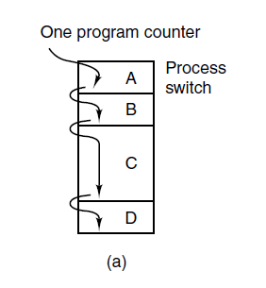
The Process Model (1)
Figure 2-1. (a) Multiprogramming of four programs.

Slide 3
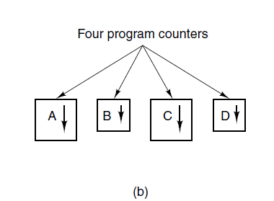
The Process Model (2)
Figure 2-1. (b) Conceptual model of
four independent, sequential processes.

Slide 4
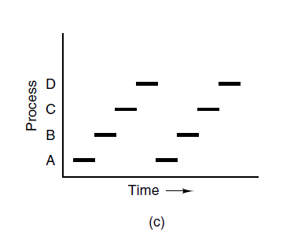
The Process Model (3)
Figure 2-1. (c) Only one program is active at once.

Slide 5
Process Creation
Four principal events that cause processes to be created:
System initialization.
Execution of a process creation system call by a running process.
A user request to create a new process.
Initiation of a batch job.

Slide 6
Process Termination
Typical conditions which terminate a process:
Normal exit (voluntary).
Error exit (voluntary).
Fatal error (involuntary).
Killed by another process (involuntary).

Slide 7
Process States (1)
Three states a process may be in:
Running (actually using the CPU at that instant).
Ready (runnable; temporarily stopped to let another process run).
Blocked (unable to run until some external event happens).

Slide 8
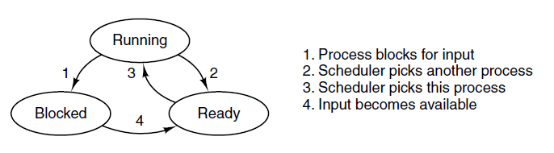
Process States (2)
Figure 2-2. A process can be in running, blocked, or ready state. Transitions between these states are as shown.

Slide 9
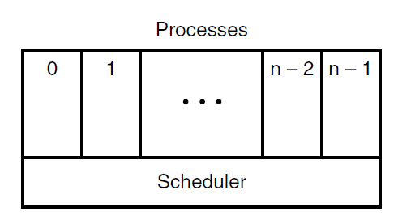
Process States (3)
Figure 2-3. The lowest layer of a process-structured operating system handles interrupts and scheduling. Above that layer are sequential processes.

Slide 10
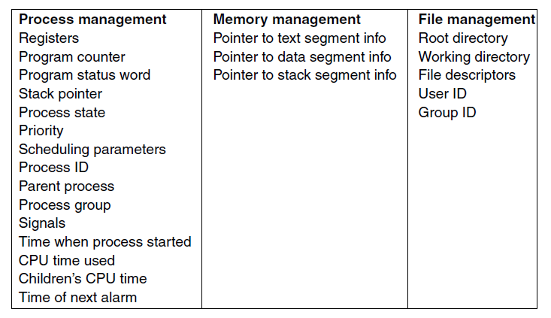
Implementation of Processes (1)
Figure 2-4. Some of the fields of a typical process table entry.

Slide 11
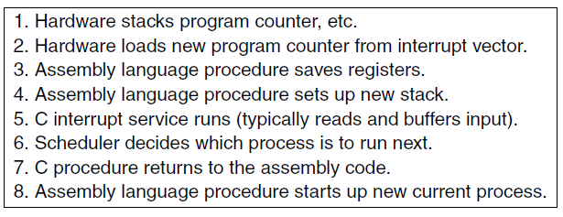
Implementation of Processes (2)
Figure 2-5. Skeleton of what the lowest level of the operating system does when an interrupt occurs.

Slide 12
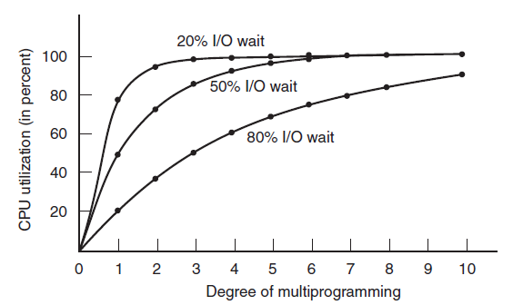

Modeling Multiprogramming
Figure 2-6. CPU utilization as a function of the number of processes in memory.

Slide 13
Process Characteristics:
Resource Ownership
Scheduling/Execution
  Process includes a virtual address space to hold the process image
    the OS performs a protection function to prevent unwanted interference between processes with respect to resources
  Follows an execution path that may be interleaved with other processes
    a process has an execution state (Running, Ready, etc.) and a dispatching priority and is scheduled and dispatched by the OS
Notes:
The discussion so far has presented the concept of a process as embodying two
characteristics:
• Resource ownership: A process includes a virtual address space to hold the
process image; recall that the process image is the collection of
program, data, stack, and attributes defined in the process control block. From
time to time, a process may be allocated control or ownership of resources,
such as main memory, I/O channels, I/O devices, and files. The OS performs a
protection function to prevent unwanted interference between processes with
respect to resources.
• Scheduling/execution: The execution of a process follows an execution path
(trace) through one or more programs (e.g., Figure 1.5). This execution may
be interleaved with that of other processes. Thus, a process has an execution
state (Running, Ready, etc.) and a dispatching priority and is the entity that is
scheduled and dispatched by the OS.

Slide 14
Processes and Threads
The unit of dispatching is referred to as a thread or lightweight process
The unit of resource ownership is referred to as a process or task
Multithreading - The ability of an OS to support multiple, concurrent paths of execution within a single process
Notes:
To distinguish the two characteristics, the unit of dispatching is usually referred to as a thread or lightweight process , while the unit of resource ownership is usually referred to as a process or task .
Multithreading refers to the ability of an OS to support multiple, concurrent paths of execution within a single process.

Slide 15
Single Threaded Approaches
A single thread of execution per process, in which the concept of a thread is not recognized, is referred to as a single-threaded approach
MS-DOS is an example
Notes:
The traditional approach of a single thread of execution per process, in which the concept of a thread is not recognized, is referred to as a single-threaded approach. The two arrangements shown in the left half of Figure 4.1 are single-threaded approaches. MS-DOS is an example of an OS that supports a single user process and a single thread.

Slide 16
Multithreaded Approaches
The right half of Figure 4.1 depicts multithreaded approaches
A Java run-time environment is an example of a system of one process with multiple threads
Notes:
The right half of Figure 4.1 depicts multithreaded approaches. A Java run-time environment is an example of a system of one process with multiple threads. Of interest in this section is the use of multiple processes, each of which supports multiple threads. This approach is taken in Windows, Solaris, and many modern versions of UNIX, among others.

Slide 17
Processes
The unit or resource allocation and a unit of protection
A virtual address space that holds the process image
Protected access to:
  processors
  other processes
  files
  I/O resources
Notes:
In a multithreaded environment, a process is defined as the unit of resource allocation and a unit of protection. The following are associated with processes:
• A virtual address space that holds the process image
• Protected access to processors, other processes (for interprocess communication), files, and I/O resources (devices and channels)

Slide 18
One or More Threads in a Process
Each thread has:
an execution state (Running, Ready, etc.)
saved thread context when not running
an execution stack
some per-thread static storage for local variables
access to the memory and resources of its process (all threads of a process share this)
Notes:
Within a process, there may be one or more threads, each with the following:
• A thread execution state (Running, Ready, etc.)
• A saved thread context when not running; one way to view a thread is as an independent program counter operating within a process
• An execution stack
• Some per-thread static storage for local variables
• Access to the memory and resources of its process, shared with all other threads in that process

Slide 19
Notes:
Figure 4.2 illustrates the distinction between threads and processes from the point of view of process management. In a single-threaded process model (i.e., there is no distinct concept of thread), the representation of a process includes its process control block and user address space, as well as user and kernel stacks to manage the call/return behavior of the execution of the process. While the process is running, it controls the processor registers. The contents of these registers are saved when the process is not running. In a multithreaded environment, there is still a single process control block and user address space associated with the process, but now there are separate stacks for each thread, as well as a separate control block for each thread containing register values, priority, and other thread-related state information.

Slide 20
Benefits of Threads
Takes less time to create a new thread than a process
Less time to terminate a thread than a process
Switching between two threads takes less time than switching between processes
Threads enhance efficiency in communication between programs
Notes:
Thus, all of the threads of a process share the state and resources of that process. They reside in the same address space and have access to the same data. When one thread alters an item of data in memory, other threads see the results if and when they access that item. If one thread opens a file with read privileges, other threads in the same process can also read from that file.
The key benefits of threads derive from the performance implications:
1. It takes far less time to create a new thread in an existing process than to
create a brand-new process. Studies done by the Mach developers show that
thread creation is ten times faster than process creation in UNIX [TEVA87].
2. It takes less time to terminate a thread than a process.
3. It takes less time to switch between two threads within the same process than to switch between processes.
4. Threads enhance efficiency in communication between different executing programs. In most operating systems, communication between independent processes requires the intervention of the kernel to provide protection and the mechanisms needed for communication. However, because threads within the same process share memory and files, they can communicate with each other without invoking the kernel.
Thus, if there is an application or function that should be implemented as a set of related units of execution, it is far more efficient to do so as a collection of threads rather than a collection of separate processes.

Slide 21
Thread Use in a
Single-User System
Foreground and background work
Asynchronous processing
Speed of execution
Modular program structure
Notes:
four examples of the uses of threads in a single-user multiprocessing system:
• Foreground and background work: For example, in a spreadsheet program,
one thread could display menus and read user input, while another thread executes user commands and updates the spreadsheet. This arrangement often increases the perceived speed of the application by allowing the program to prompt for the next command before the previous command is complete.
• Asynchronous processing: Asynchronous elements in the program can be
implemented as threads. For example, as a protection against power failure, one can design a word processor to write its random access memory (RAM) buffer to disk once every minute. A thread can be created whose sole job is periodic backup and that schedules itself directly with the OS; there is no need for fancy code in the main program to provide for time checks or to coordinate input and output.
• Speed of execution: A multithreaded process can compute one batch of data
while reading the next batch from a device. On a multiprocessor system, multiple threads from the same process may be able to execute simultaneously. Thus, even though one thread may be blocked for an I/O operation to read in a batch of data, another thread may be executing.
• Modular program structure: Programs that involve a variety of activities or a
variety of sources and destinations of input and output may be easier to design and implement using threads.

Slide 22
Threads
In an OS that supports threads, scheduling and dispatching is done on a thread basis
Most of the state information dealing with execution is maintained in thread-level data structures
  suspending a process involves suspending all threads of the process
  termination of a process terminates all threads within the process
Notes:
In an OS that supports threads, scheduling and dispatching is done on a thread basis; hence, most of the state information dealing with execution is maintained in thread-level data structures. There are, however, several actions that affect all of the threads in a process and that the OS must manage at the process level. For example, suspension involves swapping the address space of one process out of main memory to make room for the address space of another process. Because all threads in a process share the same address space, all threads are suspended at the same time. Similarly, termination of a process terminates all threads within that process.

Slide 23
Thread Execution States
The key states for a thread are:
      Running
      Ready
      Blocked
Thread operations associated with a change in thread state are:
      Spawn
      Block
      Unblock
      Finish
Notes:
As with processes, the key states for a thread are Running, Ready, and Blocked. Generally, it does not make sense to associate suspend states with threads because such states are process-level concepts. In particular, if a process is swapped out, all of its threads are necessarily swapped out because they all share the address space of the process. There are four basic thread operations associated with a change in thread state [ANDE04]:
• Spawn: Typically, when a new process is spawned, a thread for that process is also spawned. Subsequently, a thread within a process may spawn
another thread within the same process, providing an instruction pointer and arguments for the new thread. The new thread is provided with its own register context and stack space and placed on the ready queue.
• Block: When a thread needs to wait for an event, it will block (saving its user registers, program counter, and stack pointers). The processor may now turn to the execution of another ready thread in the same or a different process.
• Unblock: When the event for which a thread is blocked occurs, the thread is moved to the Ready queue.
• Finish: When a thread completes, its register context and stacks are deallocated.

Slide 24
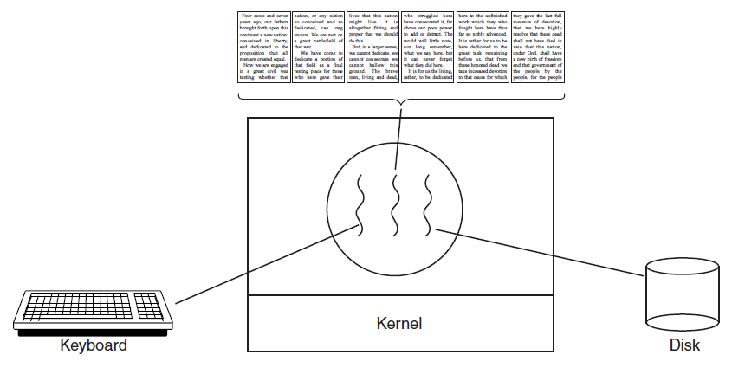
Thread Usage (1)
Figure 2-7. A word processor with three threads.

Slide 25
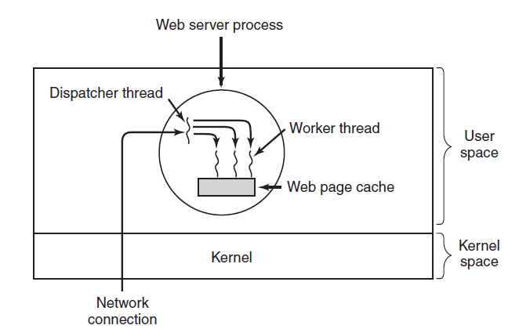
Thread Usage (2)
Figure 2-8. A multithreaded Web server.

Slide 26
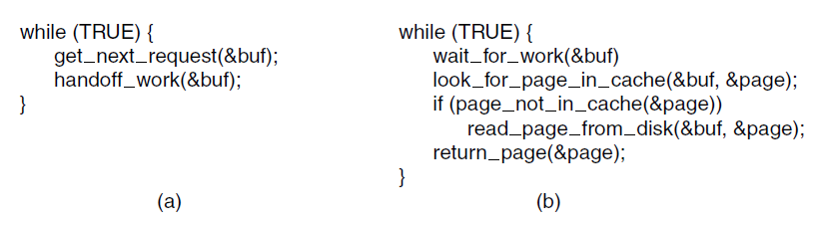
Thread Usage (3)
Figure 2-9. A rough outline of the code for Fig. 2-8.
(a) Dispatcher thread. (b) Worker thread.

Slide 27
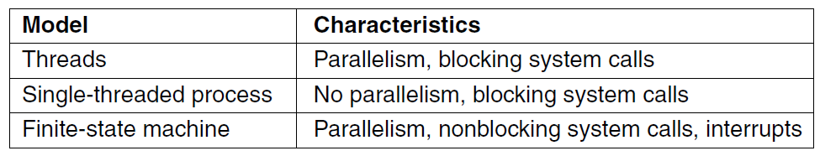
Thread Usage (4)
Figure 2-10. Three ways to construct a server.

Slide 28
Types of Threads
User Level Thread (ULT)
Kernel level Thread (KLT)
Notes:
There are two broad categories of thread implementation: user-level threads (ULTs) and kernel-level threads (KLTs). The latter are also referred to in the literature as kernel-supported threads or lightweight processes.

Slide 29
User-Level Threads (ULTs)
All thread management is done by the application
The kernel is not aware of the existence of threads
Notes:
In a pure ULT facility, all of the work of thread management is done by the application and the kernel is not aware of the existence of threads. Figure 4.5a illustrates the pure ULT approach. Any application can be programmed to be multithreaded by using a threads library, which is a package of routines for ULT management. The threads library contains code for creating and destroying threads, for passing messages and data between threads, for scheduling thread execution, and for saving and restoring thread contexts.
By default, an application begins with a single thread and begins running in that thread. This application and its thread are allocated to a single process managed by the kernel. At any time that the application is running (the process is in the Running state), the application may spawn a new thread to run within the same process. Spawning is done by invoking the spawn utility in the threads library. Control is passed to that utility by a procedure call. The threads library creates a data structure for the new thread and then passes control to one of the threads within this process that is in the Ready state, using some scheduling algorithm. When control is passed to the library, the context of the current thread is saved, and when control is passed from the library to a thread, the context of that thread is restored. The context essentially consists of the contents of user registers, the program counter, and stack pointers.

Slide 30
Advantages of ULTs
Thread switching does not require kernel mode privileges
Scheduling can be application specific
ULTs can run on any OS
Notes:
There are a number of advantages to the use of ULTs instead of KLTs, including the following:
1. Thread switching does not require kernel mode privileges because all of the
thread management data structures are within the user address space of a single process. Therefore, the process does not switch to the kernel mode to do thread management. This saves the overhead of two mode switches (user to kernel; kernel back to user).
2. Scheduling can be application specific. One application may benefit most
from a simple round-robin scheduling algorithm, while another might benefit from a priority-based scheduling algorithm. The scheduling algorithm can be tailored to the application without disturbing the underlying OS scheduler.
3. ULTs can run on any OS. No changes are required to the underlying kernel
to support ULTs. The threads library is a set of application-level functions shared by all applications.

Slide 31
Disadvantages of ULTs
In a typical OS many system calls are blocking
    as a result, when a ULT executes a system call, not only is that thread blocked, but all of the threads within the process are blocked
In a pure ULT strategy, a multithreaded application cannot take advantage of multiprocessing
Notes:
There are two distinct disadvantages of ULTs compared to KLTs:
1. In a typical OS, many system calls are blocking. As a result, when a ULT
executes a system call, not only is that thread blocked, but also all of the threads within the process are blocked.
2. In a pure ULT strategy, a multithreaded application cannot take advantage
of multiprocessing. A kernel assigns one process to only one processor at a time. Therefore, only a single thread within a process can execute at a time. In effect, we have application-level multiprogramming within a single process. While this multiprogramming can result in a significant speedup of the application, there are applications that would benefit from the ability to execute portions of code simultaneously.

Slide 32
Overcoming ULT Disadvantages
Jacketing
converts a blocking system call into a non-blocking system call
Writing an application as multiple processes rather than multiple threads
Notes:
There are ways to work around these two problems. For example, both problems can be overcome by writing an application as multiple processes rather than multiple threads. But this approach eliminates the main advantage of threads: Each switch becomes a process switch rather than a thread switch, resulting in much greater overhead. Another way to overcome the problem of blocking threads is to use a technique referred to as jacketing . The purpose of jacketing is to convert a blocking system call into a non-blocking system call. For example, instead of directly calling a system I/O routine, a thread calls an application-level I/O jacket routine. Within this jacket routine is code that checks to determine if the I/O device is busy. If it is, the thread enters the Blocked state and passes control (through the threads library) to another thread. When this thread later is given control again, the jacket routine checks the I/O device again.

Slide 33
Kernel-Level Threads (KLTs)
  Thread management is done by the kernel
      no thread management is done by the application
    Windows is an example of this approach
Notes:
In a pure KLT facility, all of the work of thread management is done by the kernel. There is no thread management code in the application level, simply an application programming interface (API) to the kernel thread facility. Windows is an example of this approach. Figure 4.5b depicts the pure KLT approach. The kernel maintains context information for the process as a whole and for individual threads within the process.

Slide 34
Advantages of KLTs
The kernel can simultaneously schedule multiple threads from the same process on multiple processors
If one thread in a process is blocked, the kernel can schedule another thread of the same process
Kernel routines can be multithreaded
Notes:
Scheduling by the kernel is done on a thread basis. This approach overcomes the two principal drawbacks of the ULT approach. First, the kernel can simultaneously schedule multiple threads from the same process on multiple processors. Second, if one thread in a process is blocked, the kernel can schedule another thread of the same process. Another advantage of the KLT approach is that kernel routines themselves can be multithreaded.

Slide 35
Disadvantage of KLTs
The transfer of control from one thread to another within the same process requires a mode switch to the kernel
Notes:
The principal disadvantage of the KLT approach compared to the ULT approach is that the transfer of control from one thread to another within the same process requires a mode switch to the kernel.

Slide 36
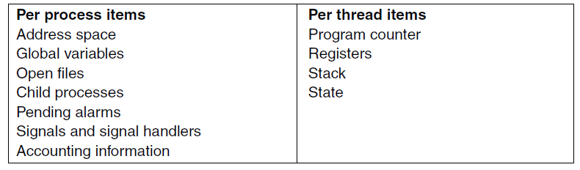
The Classical Thread Model
Figure 2-12. The first column lists some items shared by all threads in a process. The second one lists some items private to each thread.

Slide 37
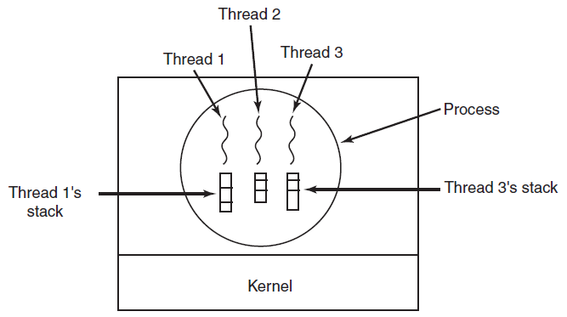
The Classical Thread Model (3)
Figure 2-13. Each thread has its own stack.

Slide 38
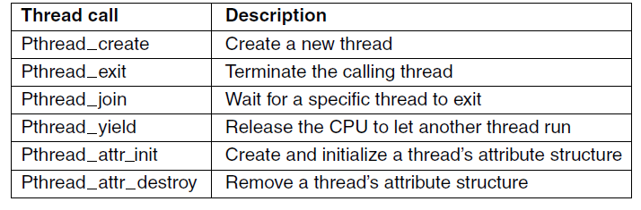
POSIX Threads (1)
Figure 2-14. Some of the Pthreads function calls.

Slide 39
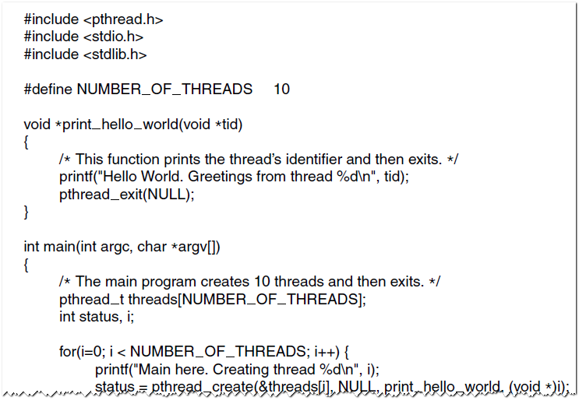
POSIX Threads (2)
Figure 2-15. An example program using threads.

Slide 40
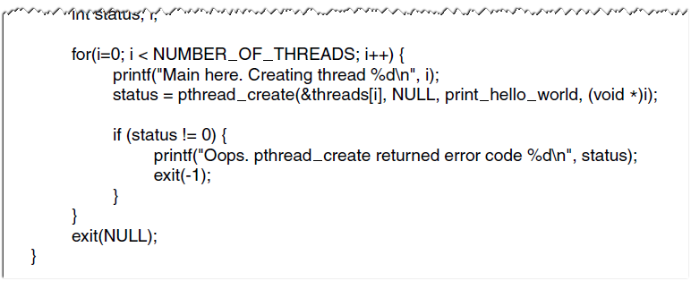
POSIX Threads (3)
Figure 2-15. An example program using threads.

Slide 41
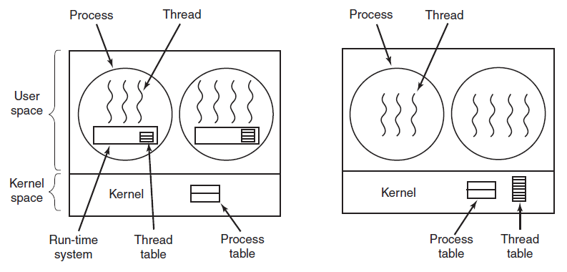
Implementing Threads in User Space
(a)
(b)
Figure 2-16. (a) A user-level threads package.
(b) A threads package managed by the kernel.

Slide 42
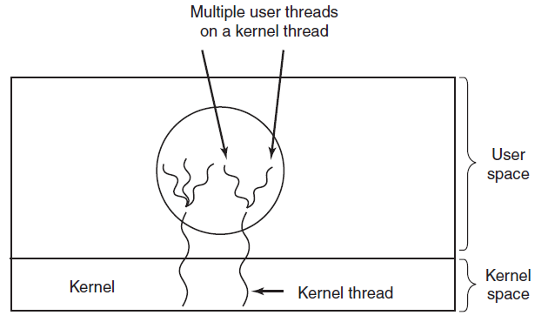
Hybrid Implementations
Figure 2-17. Multiplexing user-level threads
onto kernel-level threads.

Slide 43
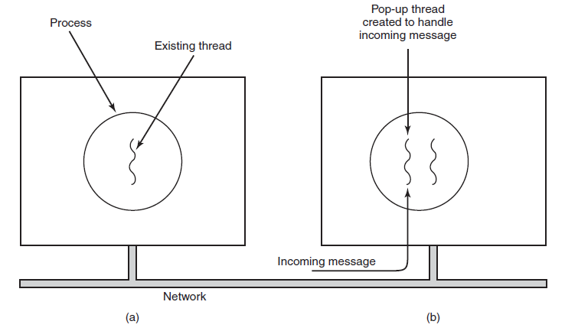
Pop-Up Threads
Figure 2-18. Creation of a new thread when a message arrives. (a) Before the message arrives. (b) After the message arrives.

Slide 44
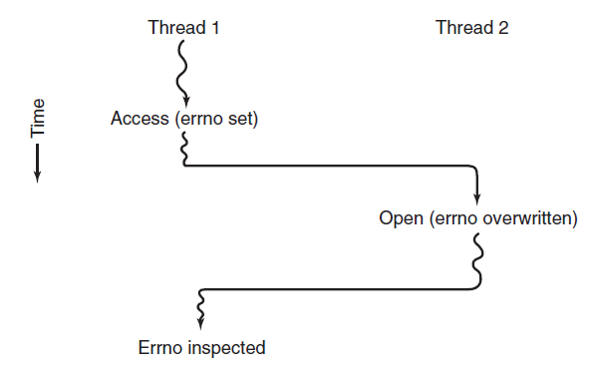
Making Single-Threaded Code Multithreaded (1)
Figure 2-19. Conflicts between threads over the
use of a global variable.

Slide 45
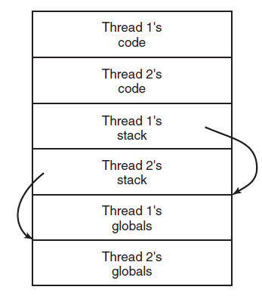
Making Single-Threaded Code Multithreaded (2)
Figure 2-20. Threads can have private global variables.

Slide 46
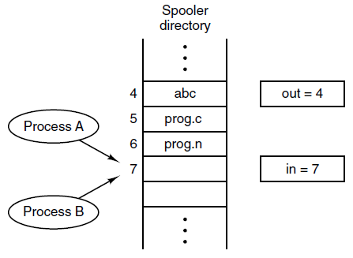
Race Conditions
Figure 2-21. Two processes want to access shared memory at the same time. Each process can read/write the shared memory.
Shared variables:
out - points to next file to be printed
in - points to the next free slot in the directory

Slide 47
Terminology
Race Condition – when two or more processes are reading or writing some shared data and the final result depends on who runs precisely when.
Critical Region - That part of the program where the shared memory is accessed.

Slide 48
Critical Regions (1)
Requirements to avoid race conditions:
No two processes may be simultaneously inside their critical regions (mutual exclusion).
No assumptions may be made about speeds or the number of CPUs.
No process running outside its critical region may block other processes.
No process should have to wait forever to enter its critical region.

Slide 49
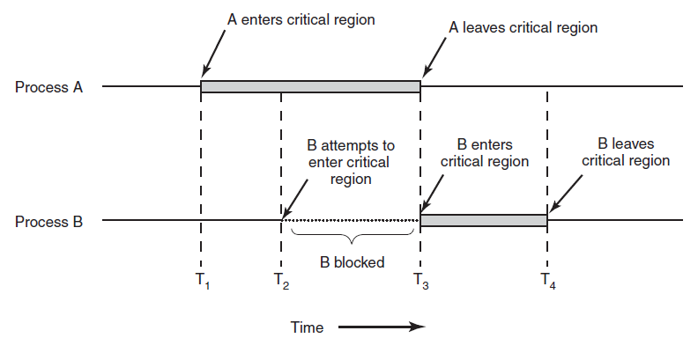
Critical Regions (2)
Figure 2-22. Mutual exclusion using critical regions.

Slide 50
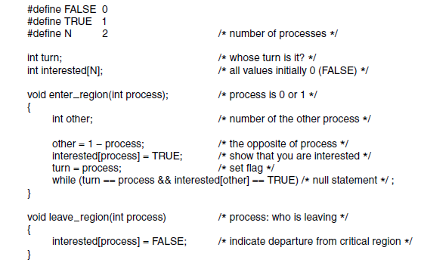
Mutual Exclusion with Busy Waiting:
Peterson’s Solution
Figure 2-24. Peterson’s solution for achieving mutual exclusion.

Slide 51
Test and Set Lock Instruction(TSL)
TSL register(RX), lock
Reads the contents of the memory word Lock into register RX and then stores a nonzero value at the memory address lock.
The operations of reading the word and storing into it are guaranteed to be indivisible – no other processor can the memory word until the instruction is finished.
The CPU executing the TSL instruction locks the memory bus to prevent other CPUs from accessing memory until it is done.

Slide 52
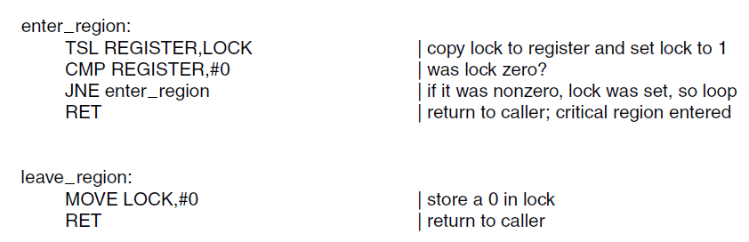
Mutual Exclusion with Busy Waiting:
The TSL Instruction (1)
Figure 2-25. Entering and leaving a critical region
using the TSL instruction.

Slide 53
XCHG Instruction
An alternative to TSL is XCHG
which exchanges the contents of two locations atomically, for example a register and a memory word.

Slide 54
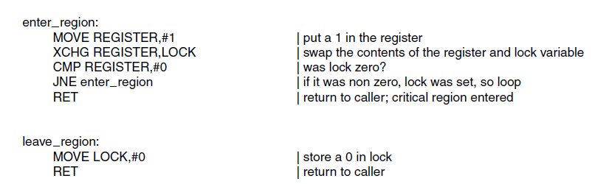
Mutual Exclusion with Busy Waiting:
The TSL Instruction (2)
Figure 2-26. Entering and leaving a critical region
using the XCHG instruction

Slide 55
Producer-Consumer Problem
Also know as the bounded buffer problem.
Two processes share a common, fixed size buffer. One of them, the producer, puts information into the buffer, and the other one, the consumer, takes it out.
When the producer wants to put a new item into a full buffer, it will sleep to be awakened when the consumer has removed one or more items.
Similarly, the consumer will sleep when it attempts to remove an item from an empty buffer to be awakened when the producer puts something into the buffer.
Race condition can occur since access to the buffer item count is unconstrained.
A wakeup sent to a process that is not (yet) sleeping is lost.

Slide 56
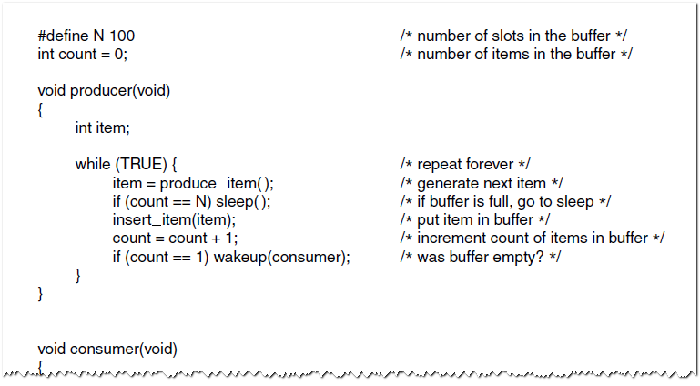
Sleep and Wakeup
The Producer-Consumer Problem (1)
Figure 2-27. The producer-consumer problem
with a fatal race condition.

Slide 57
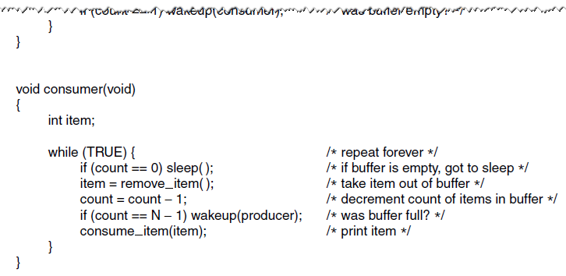
Sleep and Wakeup
The Producer-Consumer Problem (2)
Figure 2-27. The producer-consumer problem
with a fatal race condition.

Slide 58
Semaphores
A semaphore is an integer variable used to count the number of wakeups saved for future use. It can have a value of 0 indicating that no wakeups were saved, or some positive value if one or more wakeups are pending.
Operations:
down: if semaphore value is > 0 then
decrement semaphore and continue
else if value is 0, put process to sleep
The above 3 steps is an indivisible atomic action.
up: increments the value of the semaphore. If one or more processes were sleeping on that semaphore, unable to complete an earlier down operation, one of them is randomly chosen by system to complete its down.
The up operation is also indivisible
up and down operations are implemented as system calls with interrupts disabled

Slide 59
Solution using 3 semaphores
full – counts the number of full slots, initially 0
empty – counts the number of empty slots, initially buffer size(slots)
mutex – ensures that producer and consumer do not access the
buffer at the same time, initially 1

Slide 60
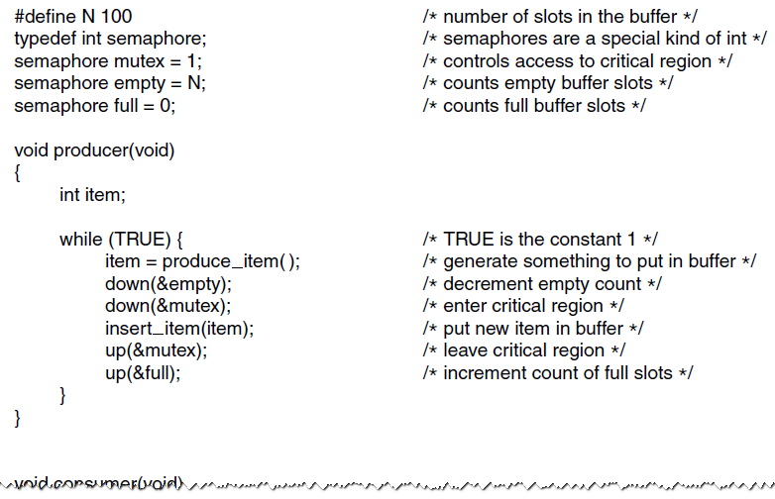
Semaphores (1)
Figure 2-28. The producer-consumer problem
using semaphores.

Slide 61
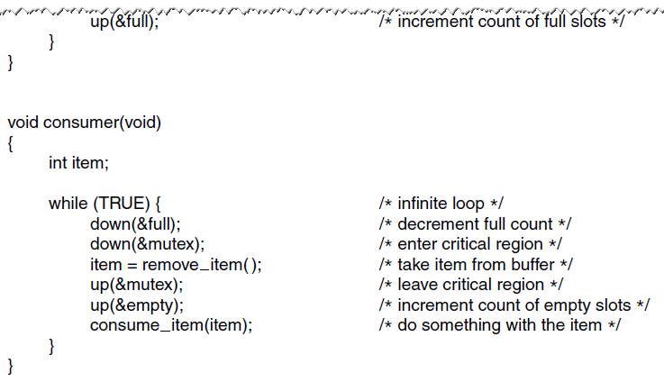
Semaphores (2)
Figure 2-28. The producer-consumer problem
using semaphores.

Slide 62
Message Passing
When processes interact with one another two fundamental requirements must be satisfied:
Message Passing is one approach to providing both of these functions
    works with distributed systems and shared memory multiprocessor and uniprocessor systems
synchronization
to enforce mutual exclusion
communication
to exchange information
Notes:
When processes interact with one another, two fundamental requirements must be satisfied: synchronization and communication. Processes need to be synchronized to enforce mutual exclusion; cooperating processes may need to exchange information. One approach to providing both of these functions is message passing. Message passing has the further advantage that it lends itself to implementation in distributed systems as well as in shared-memory multiprocessor and uniprocessor systems.

Slide 63

Message Passing
The actual function is normally provided in the form of a pair of primitives:
        send (destination, message)
        receive (source, message)
        A process sends information in the form of a message to another process designated by a destination
        A process receives information by executing the receive primitive, indicating the source and the message
Notes:
Message-passing systems come in many forms. In this section, we provide a general introduction that discusses features typically found in such systems. The actual function of message passing is normally provided in the form of a pair of primitives:
send (destination, message)
receive (source, message)
This is the minimum set of operations needed for processes to engage in message passing. A process sends information in the form of a message to another process designated by a destination . A process receives information by executing the receive primitive, indicating the source and the message .

Slide 64
Synchronization
Communication of a message between two processes implies synchronization between the two
the receiver cannot receive a message until it has been sent by another process
When a receive primitive is executed in a process there are two possibilities:
if a message has previously been sent the message is received and execution continues
if there is no waiting message the process is blocked until a message arrives or the process continues to execute, abandoning the attempt to receive
Notes:
The communication of a message between two processes implies some level of synchronization between the two: The receiver cannot receive a message until it has been sent by another process. In addition, we need to specify what happens to a process after it issues a send or receive primitive. Consider the send primitive first. When a send primitive is executed in a process, there are two possibilities: Either the sending process is blocked until the message is received, or it is not. Similarly, when a process issues a receive primitive, there are two possibilities:
1. If a message has previously been sent, the message is received and execution continues.
2. If there is no waiting message, then either (a) the process is blocked until a message arrives, or (b) the process continues to execute, abandoning the attempt to receive.

Slide 65
Producer-Consumer Problem with N Messages
The consumer starts by sending N empty messages to the producer.
Whenever the producer has an item to send, it takes an empty message and sends back a full one.
        If producer works faster than consumer, all messages will be full and producer is blocked waiting for an empty message
        If consumer works faster, then the reverse happens: the consumer will be blocked waiting for a full message.

Slide 66
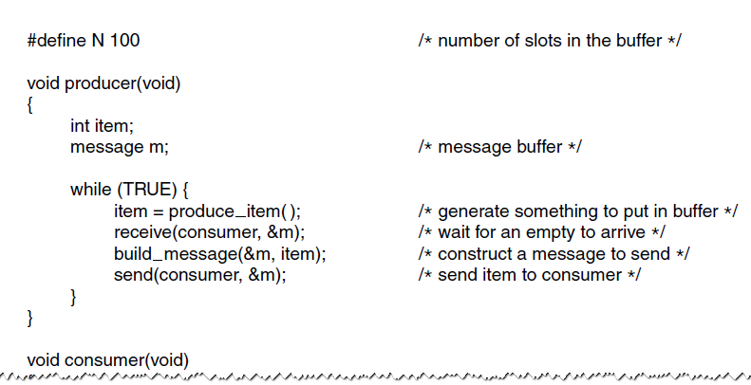
The Producer-Consumer Problem with Message Passing (1)
Figure 2-36. The producer-consumer
problem with N messages

Slide 67
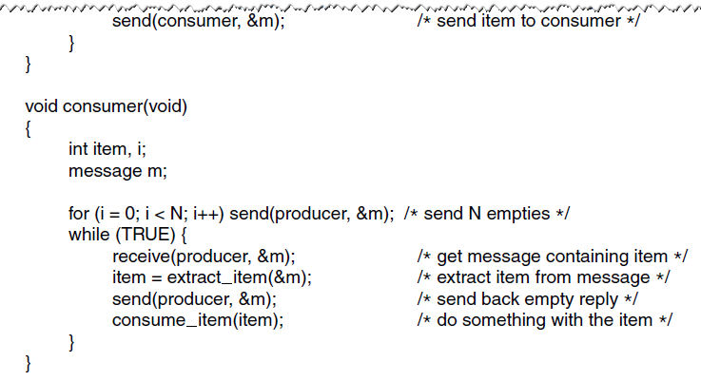
The Producer-Consumer Problem with Message Passing (2)
Figure 2-36. The producer-consumer
problem with N messages.

Slide 68
Blocking Send,
Blocking Receive
Both sender and receiver are blocked until the message is delivered
Sometimes referred to as a rendezvous
Allows for tight synchronization between processes
Notes:
Thus, both the sender and receiver can be blocking or nonblocking. Three combinations are common, although any particular system will usually have only one or two combinations implemented:
• Blocking send, blocking receive: Both the sender and receiver are blocked until the message is delivered; this is sometimes referred to as a rendezvous . This combination allows for tight synchronization between processes.

Slide 69
Nonblocking Send
Nonblocking send, blocking receive
sender continues on but receiver is blocked until the requested message arrives
most useful combination
sends one or more messages to a variety of destinations as quickly as possible
example -- a service process that exists to provide a service or resource to other processes
Nonblocking send, nonblocking receive
neither party is required to wait
Notes:
Nonblocking send, blocking receive: Although the sender may continue on, the receiver is blocked until the requested message arrives. This is probably the most useful combination. It allows a process to send one or more messages to a variety of destinations as quickly as possible. A process that must receive a message before it can do useful work needs to be blocked until such a message arrives. An example is a server process that exists to provide a service or resource to other processes.
• Nonblocking send, nonblocking receive: Neither party is required to wait.
The nonblocking send is more natural for many concurrent programming tasks. For example, if it is used to request an output operation, such as printing, it allows the requesting process to issue the request in the form of a message and then carry on. One potential danger of the nonblocking send is that an error could lead to a situation in which a process repeatedly generates messages. Because there is no blocking to discipline the process, these messages could consume system resources, including processor time and buffer space, to the detriment of other processes and the OS. Also, the nonblocking send places the burden on the programmer to determine that a message has been received: Processes must employ reply messages to acknowledge receipt of a message.
For the receive primitive, the blocking version appears to be more natural for many concurrent programming tasks. Generally, a process that requests a message will need the expected information before proceeding. However, if a message is lost, which can happen in a distributed system, or if a process fails before it sends an anticipated message, a receiving process could be blocked indefinitely. This problem can be solved by the use of the nonblocking receive . However, the danger of this approach is that if a message is sent after a process has already executed a matching receive , the message will be lost. Other possible approaches are to allow a process to test whether a message is waiting before issuing a receive and
allow a process to specify more than one source in a receive primitive. The latter approach is useful if a process is waiting for messages from more than one source
and can proceed if any of these messages arrive.

Slide 70
Addressing
  Schemes for specifying processes in send and receive primitives fall into two categories:
Direct addressing
Indirect addressing
Notes:
Clearly, it is necessary to have a way of specifying in the send primitive which process is to receive the message. Similarly, most implementations allow a receiving process to indicate the source of a message to be received.
The various schemes for specifying processes in send and receive primitives fall into two categories: direct addressing and indirect addressing.

Slide 71
Direct Addressing
    Send primitive includes a specific identifier of the destination process
    Receive primitive can be handled in one of two ways:
      require that the process explicitly designate a sending process
      effective for cooperating concurrent processes
      implicit addressing
      source parameter of the receive primitive possesses a value returned when the receive operation has been performed
Notes:
With direct addressing , the send primitive includes a specific identifier of the destination process. The receive primitive can be handled in one of two ways. One possibility is to require that the process explicitly designate a sending process. Thus, the process must know ahead of time from which process a message is expected. This will often be effective for cooperating concurrent processes.
In other cases, however, it is impossible to specify the anticipated source process. An example is a printer server process, which will accept a print request message from any other process. For such applications, a more effective approach is the use of implicit addressing. In this case, the source parameter of the receive primitive possesses a value returned when the receive operation has been performed.

Slide 72
Indirect Addressing
Messages are sent to a shared data structure consisting of queues that can temporarily hold messages
Queues are referred to as mailboxes
One process sends a message to the mailbox and the other process picks up the message from the mailbox
Allows for greater flexibility in the use of messages
Notes:
The other general approach is indirect addressing . In this case, messages are not sent directly from sender to receiver but rather are sent to a shared data structure consisting of queues that can temporarily hold messages. Such queues are generally referred to as mailboxes . Thus, for two processes to communicate, one process sends a message to the appropriate mailbox and the other process picks up the message from the mailbox.
A strength of the use of indirect addressing is that, by decoupling the sender and receiver, it allows for greater flexibility in the use of messages.

Slide 73
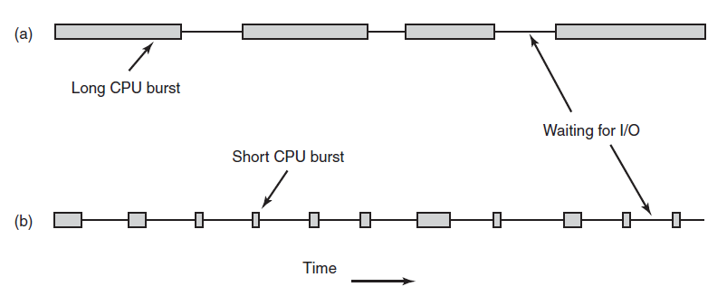
Introduction to Scheduling
Process Behavior
Figure 2-39. Bursts of CPU usage alternate with periods of waiting for I/O. (a) A CPU-bound process. (b) An I/O-bound process.

Slide 74
Nonpreemptive vs Preemptive
  Nonpreemptive
  once a process is in the running state, it will continue until it terminates or blocks itself for I/O
  Preemptive
  currently running process may be interrupted and moved to ready state by the OS
  preemption may occur when new process arrives, on an interrupt, or periodically based on a clock interrupt.

Slide 75
Throughput – number of jobs completed per time unit
Turnaround time = Finish time – Arrival time

Slide 76
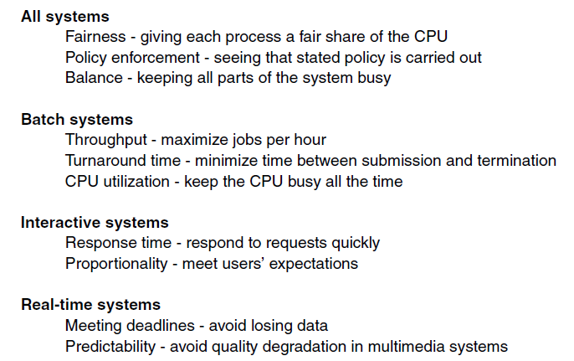
Scheduling Algorithm Goals
Figure 2-40. Some goals of the scheduling algorithm under different circumstances.

Slide 77
Scheduling Algorithms
First-Come First-Served
Shortest Job First
Shortest Remaining Time Next (a preemptive version of shortest job first – select process whose remaining run time is the shortest)
Round-Robin Scheduling
Priority Scheduling
Multiple Priority Queues
Shortest Process Next

Slide 78
First-Come-First-Served (FCFS)
Simplest scheduling policy
Also known as first-in-first-out (FIFO) or a strict queuing scheme
When the current process ceases to execute, the longest process in the Ready queue is selected
Performs much better for long processes than short ones
Tends to favor processor-bound processes over I/O-bound processes
Notes:
The simplest scheduling policy is first-come-first-served
(FCFS), also known as first-in-first-out (FIFO) or a strict queuing scheme.
As each process becomes ready, it joins the ready queue. When the currently
running process ceases to execute, the process that has been in the ready queue the
longest is selected for running.
FCFS performs much better for long processes than short ones.
Another difficulty with FCFS is that it tends to favor processor-bound processes
over I/O-bound processes. Consider that there is a collection of processes, one of
which mostly uses the processor (processor bound) and a number of which favor I/O
(I/O bound). When a processor-bound process is running, all of the I/O bound processes
must wait. Some of these may be in I/O queues (blocked state) but may move
back to the ready queue while the processor-bound process is executing. At this point,
most or all of the I/O devices may be idle, even though there is potentially work for
them to do. When the currently running process leaves the Running state, the ready
I/O-bound processes quickly move through the Running state and become blocked on
I/O events. If the processor-bound process is also blocked, the processor becomes idle.
Thus, FCFS may result in inefficient use of both the processor and the I/O devices.
FCFS is not an attractive alternative on its own for a uniprocessor system.
However, it is often combined with a priority scheme to provide an effective scheduler.
Thus, the scheduler may maintain a number of queues, one for each priority
level, and dispatch within each queue on a first-come-first-served basis. We see one
example of such a system later, in our discussion of feedback scheduling.

Slide 79
FCFS (in the order ABCDE at time 0)
Process | Service time | Arrival time | Completion time | Response time
A | 3 | 0 | 3 | 3
B | 6 | 0 | 9 | 9
C | 4 | 0 | 13 | 13
D | 5 | 0 | 18 | 18
E | 2 | 0 | 20 | 20
 |  |  | total | 63
 |  |  | average | 12.6

Slide 80
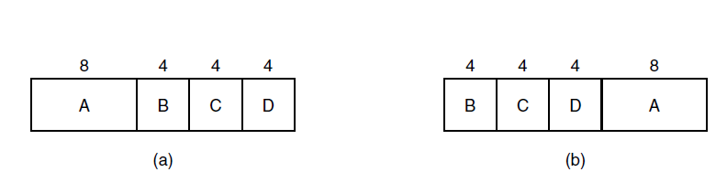
Shortest Job First(SJF)
Figure 2-41.
(a) Running four jobs in FCFS order.
(b) Running them in shortest job first order.
Notes:
This is a nonpreemptive policy in which the process with the shortest expected processing
time is selected next. Thus, a short process will jump to the head of the queue past
longer jobs.
One difficulty with the SJF policy is the need to know or at least estimate the
required processing time of each process. For batch jobs, the system may require the
programmer to estimate the value and supply it to the operating system. If the programmer’s
estimate is substantially under the actual running time, the system may abort the
job. In a production environment, the same jobs run frequently, and statistics may be
gathered. For interactive processes, the operating system may keep a running average
of each “burst” for each process.
A risk with SJF is the possibility of starvation for longer processes, as long
as there is a steady supply of shorter processes. On the other hand, although SJF
reduces the bias in favor of longer jobs, it still is not desirable for a time-sharing or
transaction processing environment because of the lack of preemption.

Slide 81
SJF (at time 0 ABCDE in ready queue)
Process | Service time | Arrival time | Completion time | Response time
E | 2 | 0 | 2 | 2
A | 3 | 0 | 5 | 5
C | 4 | 0 | 9 | 9
D | 5 | 0 | 14 | 14
B | 6 | 0 | 20 | 20
 |  |  | total | 50
 |  |  | average | 10

Slide 82
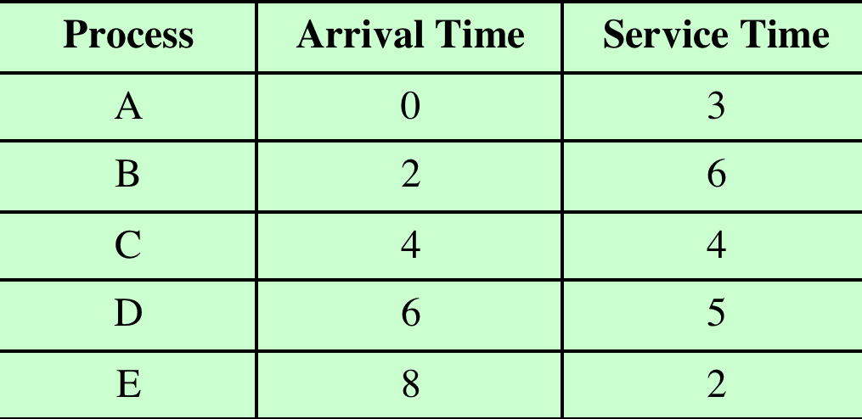

Table 9.4
Process Scheduling Example
Notes:
As we describe the various scheduling policies, we will use the set of processes
in Table 9.4 as a running example. We can think of these as batch jobs, with the
service time being the total execution time required. Alternatively, we can consider
these to be ongoing processes that require alternate use of the processor and I/O
in a repetitive fashion. In this latter case, the service times represent the processor
time required in one cycle. In either case, in terms of a queuing model, this quantity
corresponds to the service time.

Slide 83
FCFS
Process | Service time | Arrival time | Completion time | Response time
A | 3 | 0 | 3 | 3
B | 6 | 2 | 9 | 7
C | 4 | 4 | 13 | 9
D | 5 | 6 | 18 | 12
E | 2 | 8 | 20 | 12
 |  |  | total | 43
 |  |  | average | 8.6

Slide 84
SJF
Process | Service time | Arrival time | Completion time | Response time
A | 3 | 0 | 3 | 3
B | 6 | 2 | 9 | 7
E | 2 | 8 | 11 | 3
C | 4 | 4 | 15 | 11
D | 5 | 6 | 20 | 14
 |  |  | total | 38
 |  |  | average | 7.6

Slide 85
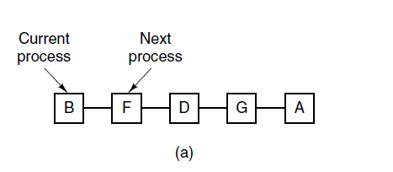
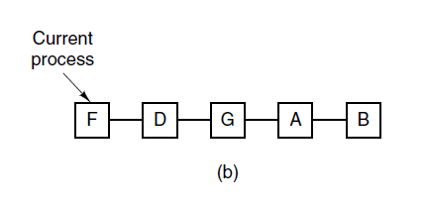
Round-Robin Scheduling
Figure 2-42. Round-robin scheduling. (a) The list of
runnable processes. (b) The list of runnable
processes after B uses up its quantum.

Slide 86
Round Robin
Uses preemption based on a clock
Also known as time slicing because each process is given a slice of time before being preempted
Principal design issue is the length of the time quantum, or slice, to be used
Particularly effective in a general-purpose time-sharing system or transaction processing system
One drawback is its relative treatment of processor-bound and I/O-bound processes
Notes:
A straightforward way to reduce the penalty that short jobs suffer
with FCFS is to use preemption based on a clock. The simplest such policy is round
robin. A clock interrupt is generated at periodic intervals. When the interrupt
occurs, the currently running process is placed in the ready queue, and the next
ready job is selected on a FCFS basis. This technique is also known as time slicing ,
because each process is given a slice of time before being preempted.
With round robin, the principal design issue is the length of the time quantum,
or slice, to be used. If the quantum is very short, then short processes will move
through the system relatively quickly. On the other hand, there is processing overhead
involved in handling the clock interrupt and performing the scheduling and
dispatching function. Thus, very short time quanta should be avoided.
Round robin is particularly effective in a general-purpose time-sharing system
or transaction processing system. One drawback to round robin is its relative
treatment of processor-bound and I/O-bound processes. Generally, an I/O-bound
process has a shorter processor burst (amount of time spent executing between I/O
operations) than a processor-bound process. If there is a mix of processor-bound
and I/O-bound processes, then the following will happen: An I/O-bound process
uses a processor for a short period and then is blocked for I/O; it waits for the
I/O operation to complete and then joins the ready queue. On the other hand, a
processor-bound process generally uses a complete time quantum while executing
and immediately returns to the ready queue. Thus, processor-bound processes
tend to receive an unfair portion of processor time, which results in poor performance
for I/O-bound processes, inefficient use of I/O devices, and an increase in the
variance of response time.

Slide 87
Round Robin (RR)
Each process gets a small unit of CPU time (time quantum q), usually 10-100 milliseconds. After this time has elapsed, the process is preempted and added to the end of the ready queue.
If there are n processes in the ready queue and the time quantum is q, then each process gets 1/n of the CPU time in chunks of at most q time units at once. No process waits more than (n-1)q time units.

Slide 88
Round Robin
Timer interrupts every quantum to schedule next process
Performance
  q large ⇒ FIFO
  q small ⇒ q must be large with respect to context switch, otherwise overhead is too high

Slide 89
Example of RR with Time Quantum = 4
Process Burst Time
P₁ 24
P₂ 3
P₃ 3
The Gantt chart is:
Typically, higher average turnaround than SJF, but better response
q should be large compared to context switch time
q usually 10ms to 100ms, context switch < 10 usec

Slide 90
Priority Scheduling
A priority number (integer) is associated with each process
The CPU is allocated to the process with the highest priority (smallest integer ≡ highest priority)
  Preemptive
  Nonpreemptive

Slide 91
Priority scheduling
SJF is priority scheduling where priority is the inverse of predicted next CPU burst time
Problem ≡ Starvation – low priority processes may never execute
Solution ≡ Aging – as time progresses increase the priority of the process

Slide 92
Example of Priority Scheduling
ProcessA arri Burst TimeT Priority
P₁ 10 3
P₂ 1 1
P₃ 2 4
P₄ 1 5
P₅ 5 2
Priority scheduling Gantt Chart
Average turnaround time = 12 msec
P₂
P₅
P₁
P₃
P₄

Slide 93
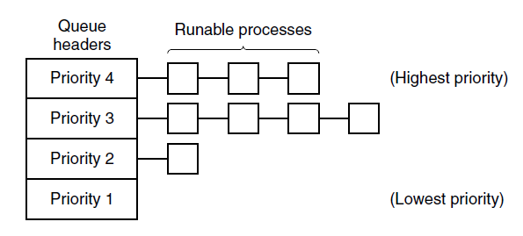
Priority Scheduling
Figure 2-43. A scheduling algorithm with four priority classes.

Slide 94
Priority classes scheduling
If priority class 4 is not empty then run each process in that queue for one quantum, round-robin fashion, ignoring lower-priority classes.
If priority class 4 is empty, then run class 3 round-robin.
If class 3 and 4 are both empty, then run class 2 round-robin, and so on.

Slide 95
End
Chapter 2

